Slide 1
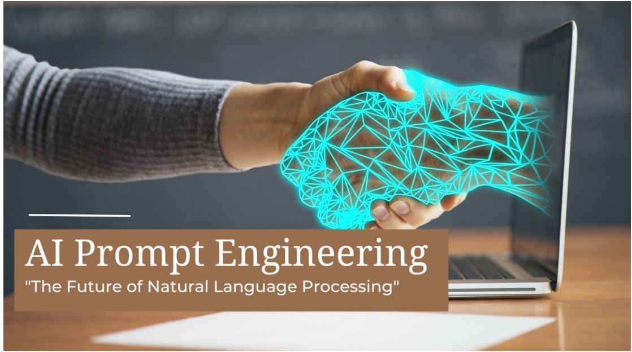
AI & Prompt Engineering
Created by
Yugal Y. Kosamshile

Slide 2
Introduction to AI & Prompt Engineering
Artificial Intelligence (AI)
Prompt Engineering
Applications
AI refers to the simulation of human intelligence in machines that are programmed to think and learn like humans.
Prompt engineering focuses on designing and generating prompts to maximize the performance of AI language models.
AI and prompt engineering are increasingly used in various fields such as healthcare, finance, and marketing.

Slide 3

What is Prompt Engineering?
Language Model Training
Optimizing AI Performance
It focuses on training language models to understand and interpret human prompts accurately.
Prompt engineering involves crafting precise and effective prompts to achieve desired outcomes from AI models.

Slide 4
Importance & Applications
Significance of AI
Real-World Applications
Impact on Society
AI plays a pivotal role in enhancing productivity, decision-making, and innovation across industries.
AI and prompt engineering are applied in natural language processing, chatbots, and personalized content generation.
They have the potential to revolutionize healthcare, education, and accessibility for people with disabilities.

Slide 5

Key Concepts in AI
Machine Learning
Deep Learning
AI systems utilize machine learning algorithms to improve their performance over time based on data patterns.
It involves training neural networks with vast amounts of data to make complex decisions and predictions.

Slide 6

Key Concepts in Prompt Engineering
Prompt Design
Optimization Techniques
Designing prompts that elicit specific responses from AI models by leveraging language understanding.
Implementing strategies to fine-tune prompts for improved performance and output quality.

Slide 7

Future Scope
Advancements in AI
Prompt Engineering Innovations
Continued advancements will lead to more sophisticated AI models that can address complex real-world problems.
Future developments will focus on refining prompt engineering methods for enhanced AI language model capabilities.

Slide 8
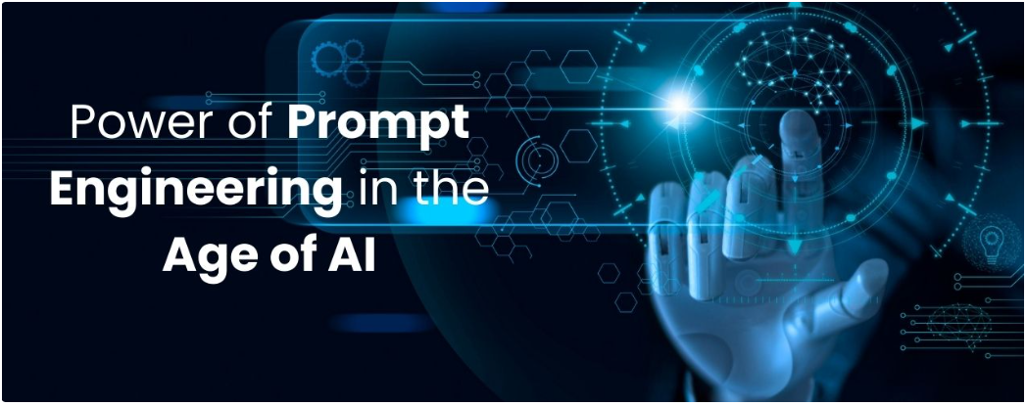
Conclusion
Recap of key point
Contact Information
Call to Action
AI's significance, prompt engineering's role, key concepts, and future prospects.
Your email or other relevant contact details for further inquiries or discussions.
Encouragement to further explore AI and prompt engineering, considering its impact and potential.

